Slide 1
CSBP 461 Internet Computing: Java Server Pages (JSP)
M. Elarbi Badidi

Slide 2
Objectives
Introduce JSP Web components
Compare JSP with Servlets
Present the JSP life cycle
Introduce JSP scripting elements
Discuss JSP standard actions
Discuss Custom Tags Library
Introduce the Expression Language

Slide 3
Java Server Pages (JSP)
The Java Server Pages (JSP) technology allows Web developers to generate static and dynamic HTTP contents. The JSP is just like the ordinary Web pages with some additional embedded Java code. For example, a simplest JSP page can just be a simple HTML page with a .JSP extension.
<HTML>
<BODY>
<H1> This is a simplest JSP page <H1>
</BODY>
<HTML>
This is the simplest JSP page, without any embedded Java code. It can be treated just like an HTML page.

Slide 4
A Simple JSP Page
(Blue: static, Red: Dynamic contents)
<html>
<body>
Hello World!
<br>
Current time is <%= new java.util.Date() %>
</body>
</html>

Slide 5
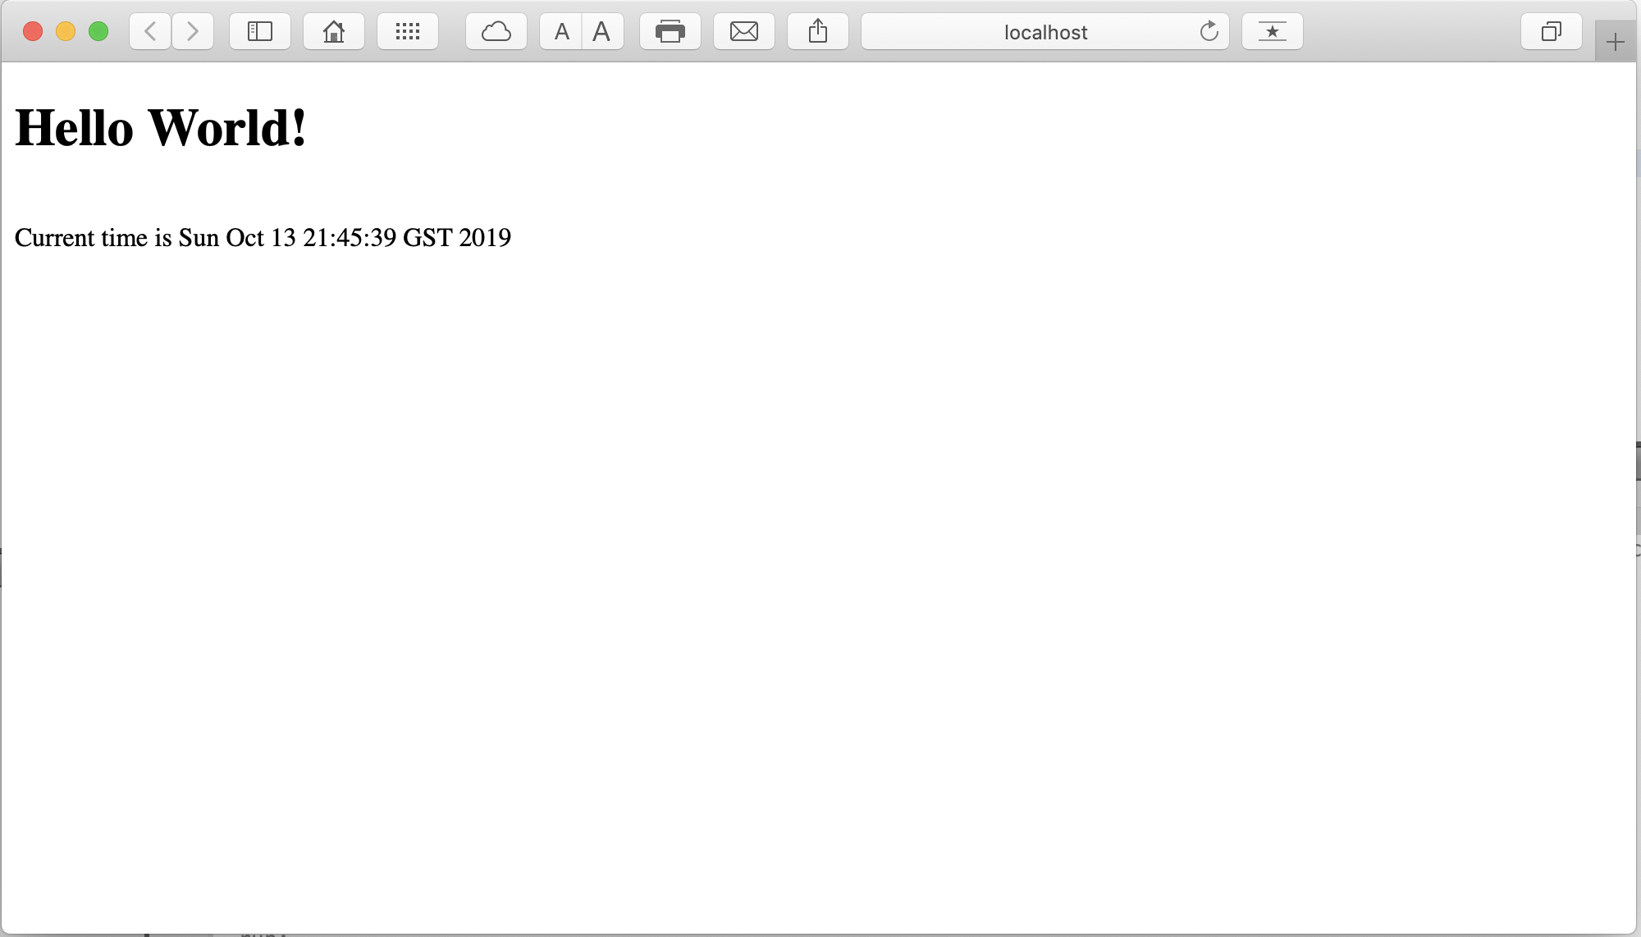
Output

Slide 6
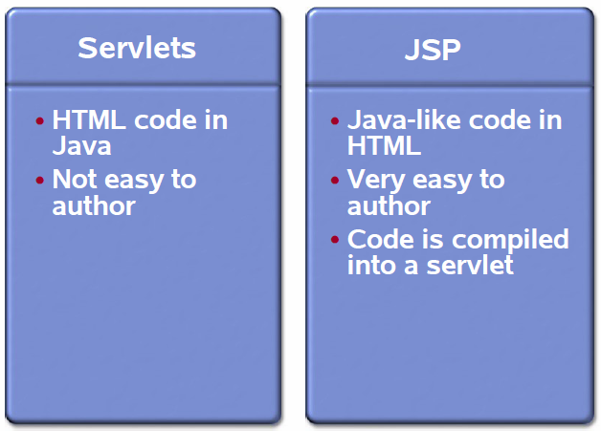
Servlet vs. JSP

Slide 7
JSP Benefits
Content and display logic are separated
Simplify web application development with JSP, JavaBeans and custom tags
Supports software reuse through the use of components (JavaBeans, Custom tags)
Automatic deployment
Recompile automatically when changes are made to JSP pages
Easier to author web pages
Platform-independent

Slide 8
Why JSP over Servlet?
Servlets can do a lot of things, but it is pain to:
Use those println() statements to generate HTML page
Maintain that HTML page
Although JSP technically can’t do anything servlets can’t do, JSP makes it easier to:
Write HTML
Read and maintain the HTML
JSP makes it possible to:
Use standard HTML tools such as Macromedia DreamWeaver or Adobe GoLive.
Have different members of your team do the HTML layout than do the Java programming
JSP encourages you to
Separate the (Java) code that creates the content from the (HTML) code that presents it
7

Slide 9
Java Server Pages (JSP) (cont.)
Most of JSP pages have embedded Java code. This allows access to server-side data and implements business logic.
Java Server Pages are an extension of Java Servlet technology. JSP can not work without Servlet container support.
When a Web server gets a JSP request from a client the JSP engine converts the JSP page into a Java Servlet code and compiles it into Servlet classes.
The generated Servlet code is run on the Servlet container and finally sends the results back to the Web client.
JSP focuses on the data presentation while the other Web components such as Servlets, JavaBeans, custom tags, and EJB take care of business logic processing.

Slide 10
Java Server Pages (JSP) (cont.)
JSP also makes the tag library extensible so that developers can develop their own reusable custom tags.
The new features of JSP 2.0 such as Expression Language (EL) make Web server page authoring even easier. JSP provides a more consistent way for Web developers to access different types of data such as implicit server objects, JavaBeans, Servlets, and even other remote distributed data.

Slide 11
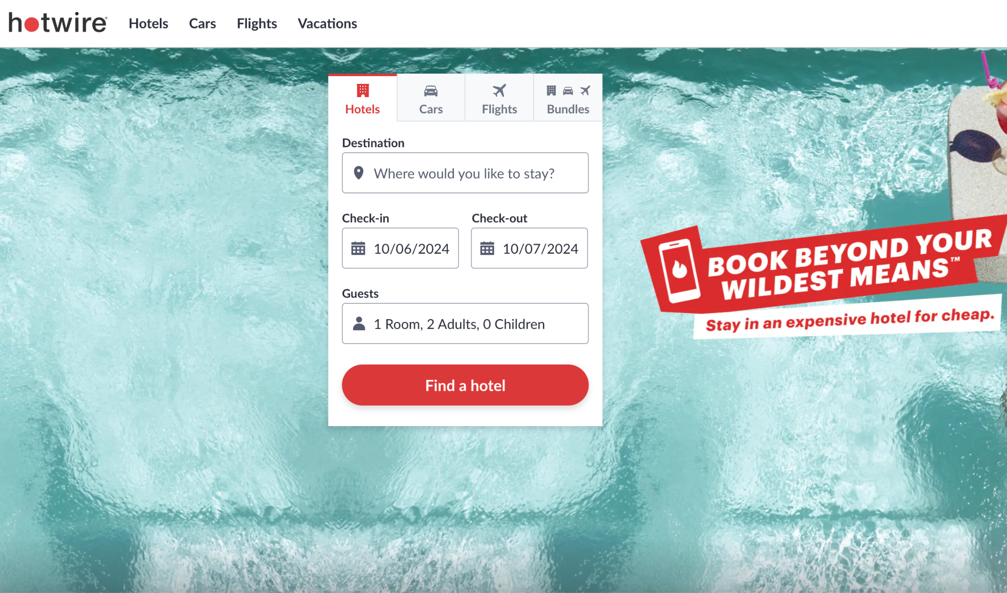

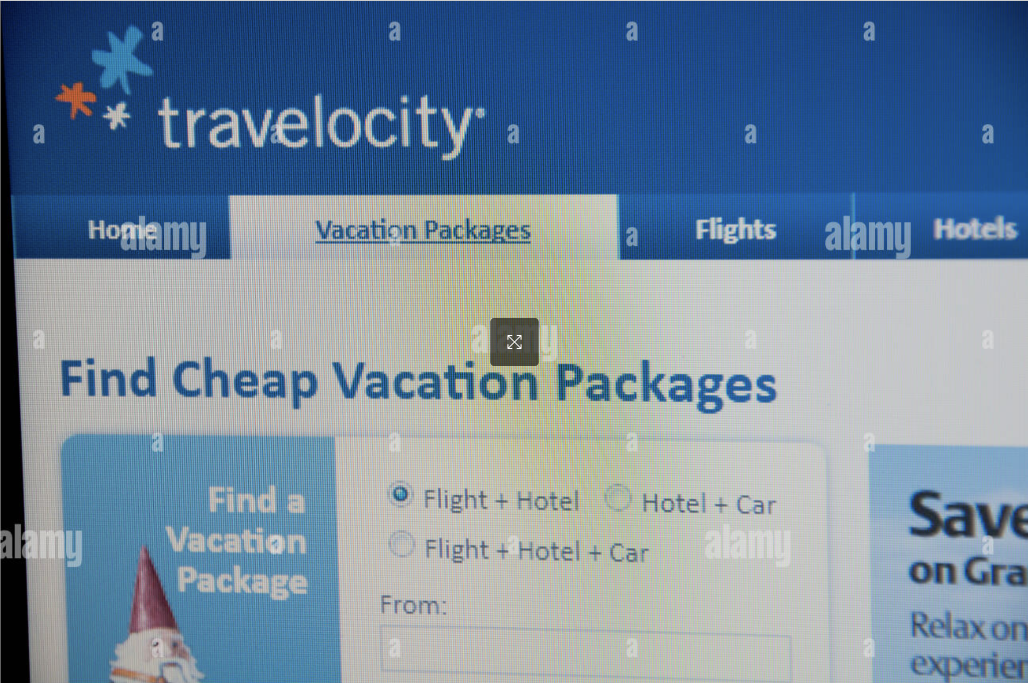
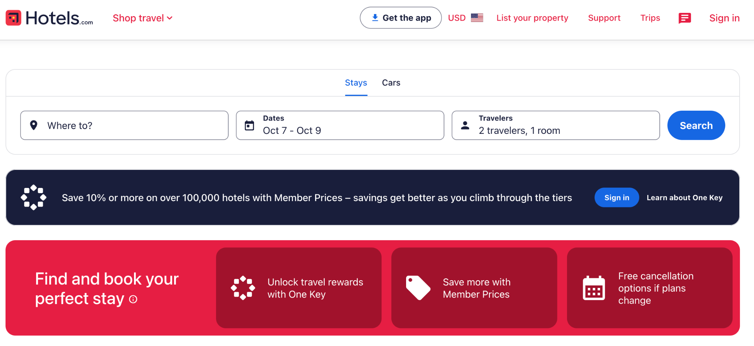
JSP/Servlets in the Real World: Travel Sites

Slide 12
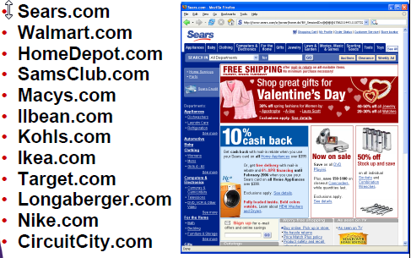

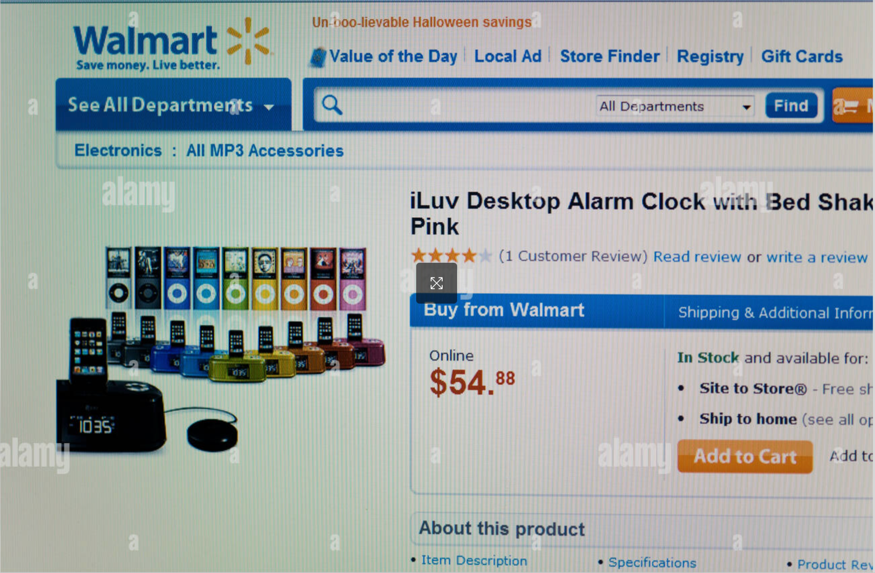
JSP/Servlets in the Real World: Retail

Slide 13

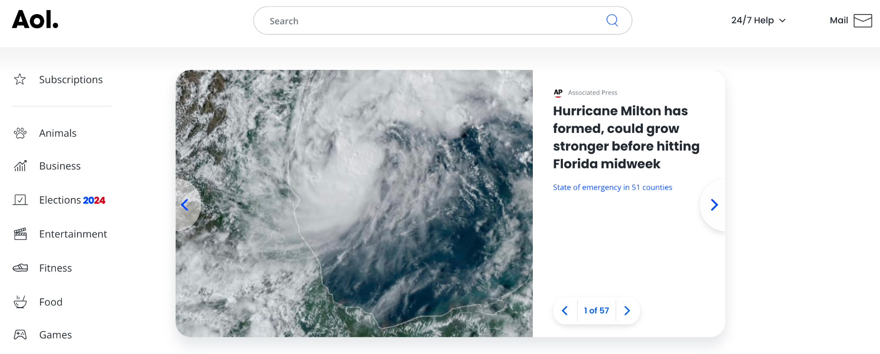

JSP/Servlets in the Real World: Search/Portals
www.ask.com
www.aol.com
www.duckduckgo.com
www.yahoo.com
www.ecosia.org

Slide 14
JSP Basics
JSP Life Cycle
JSP is a Web server side programming technology based on Servlet technology. The JSP specification is built on the top of the Servlet API.
Any JSP page is translated into a Java Servlet by a JSP engine at runtime so that the JSP life cycle is determined by Servlet technology.
The JSP engine is a JSP specification implementation which comes with web servers that implement JSP. Tomcat is one example.
When a request comes to a JSP page, it may come from client browser or come from another Web component such as a Servlet or JSP.

Slide 15
JSP Life Cycle (cont.)
The Web server asks the JSP engine to check whether the JSP page has never been accessed before, or it has been modified since its last access. If this is the case the JSP engine will
Parse the JSP document to translate into a Servlet Java file
Compile the Servlet Java file into a class file.
Then the Servlet container loads the Servlet class for execution and sends the results back to the client.

Slide 16
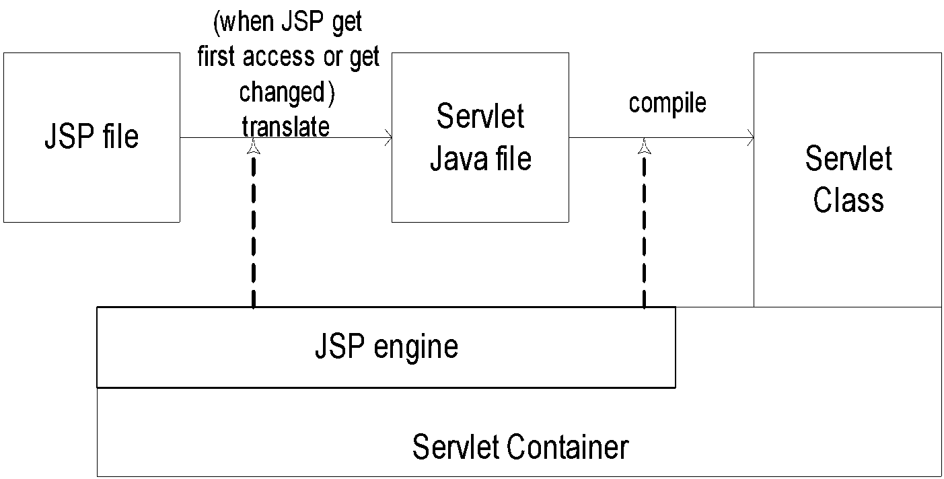
JSP Life Cycle (cont.)
Process of a JSP page

Slide 17
The JSP Page Life Cycle
Generate
Web
Browser
HTTP Request
http://localhost:8080/MySum.jsp
Web Server
Yes
MySum_jsp.java
First
Call
Compile
HTML
Page
No
MySum_jsp.class
Call the method
_jspService ( .. , .. )
HTTP Response
HTML
Page
Generate

Slide 18
JSP Life Cycle (cont.)
JSP initialization
The jspInit() method is executed first after the JSP is loaded.
If the JSP developer needs to perform any JSP-specific initialization such as database connections at the beginning this method can be specified.
<%! . . . %> is a JSP declaration element which is used to declare variable or methods. The jspInit() is only called once during any JSP component life time.
<%! public void jspInit(){ . . . } %>

Slide 19
JSP Life Cycle (cont.)
JSP execution
Public _service (HttpServletRequest req, HttpServletResponse res)
“_service” is a JSP service method the same as the service() method of a Servlet class. This method never needs to be customized. All Java code defined in scripting elements are inserted in this method by JSP engine.
JSP termination
<%! public void jspDestroy(){ . . . } %>
This method allows developers to specify resource cleanup jobs such as database disconnections.

Slide 20
First Simple Interactive JSP example (cont.)
<html>
<head>
<title>Demo1</title>
</head>
<body>
<h3>Please enter the user name :</h3><p>
<form action="/jsp/helloJsp.jsp">
UserName : <input type="text" name="userName"><br><br>
<input type="submit" value="Submit">
</form>
</body>
</html>
Basically, this JSP page takes a user name input from a Web client and generates a dynamic page to welcome the user.

Slide 21
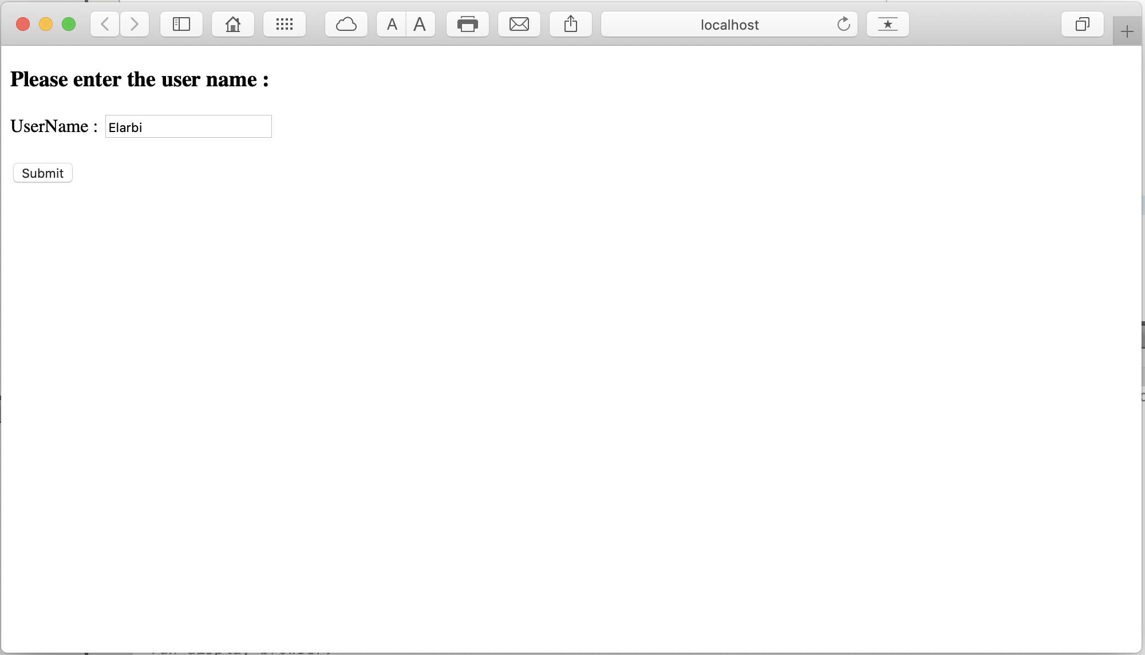
First Simple Interactive JSP example (cont.)
This HTML takes a string of a user name from the HTML form and submits a request to helloJsp.jsp as specified in the action attribute of the HTML form. For example, a user types SPSU in the form and pushes the Submit button.

Slide 22
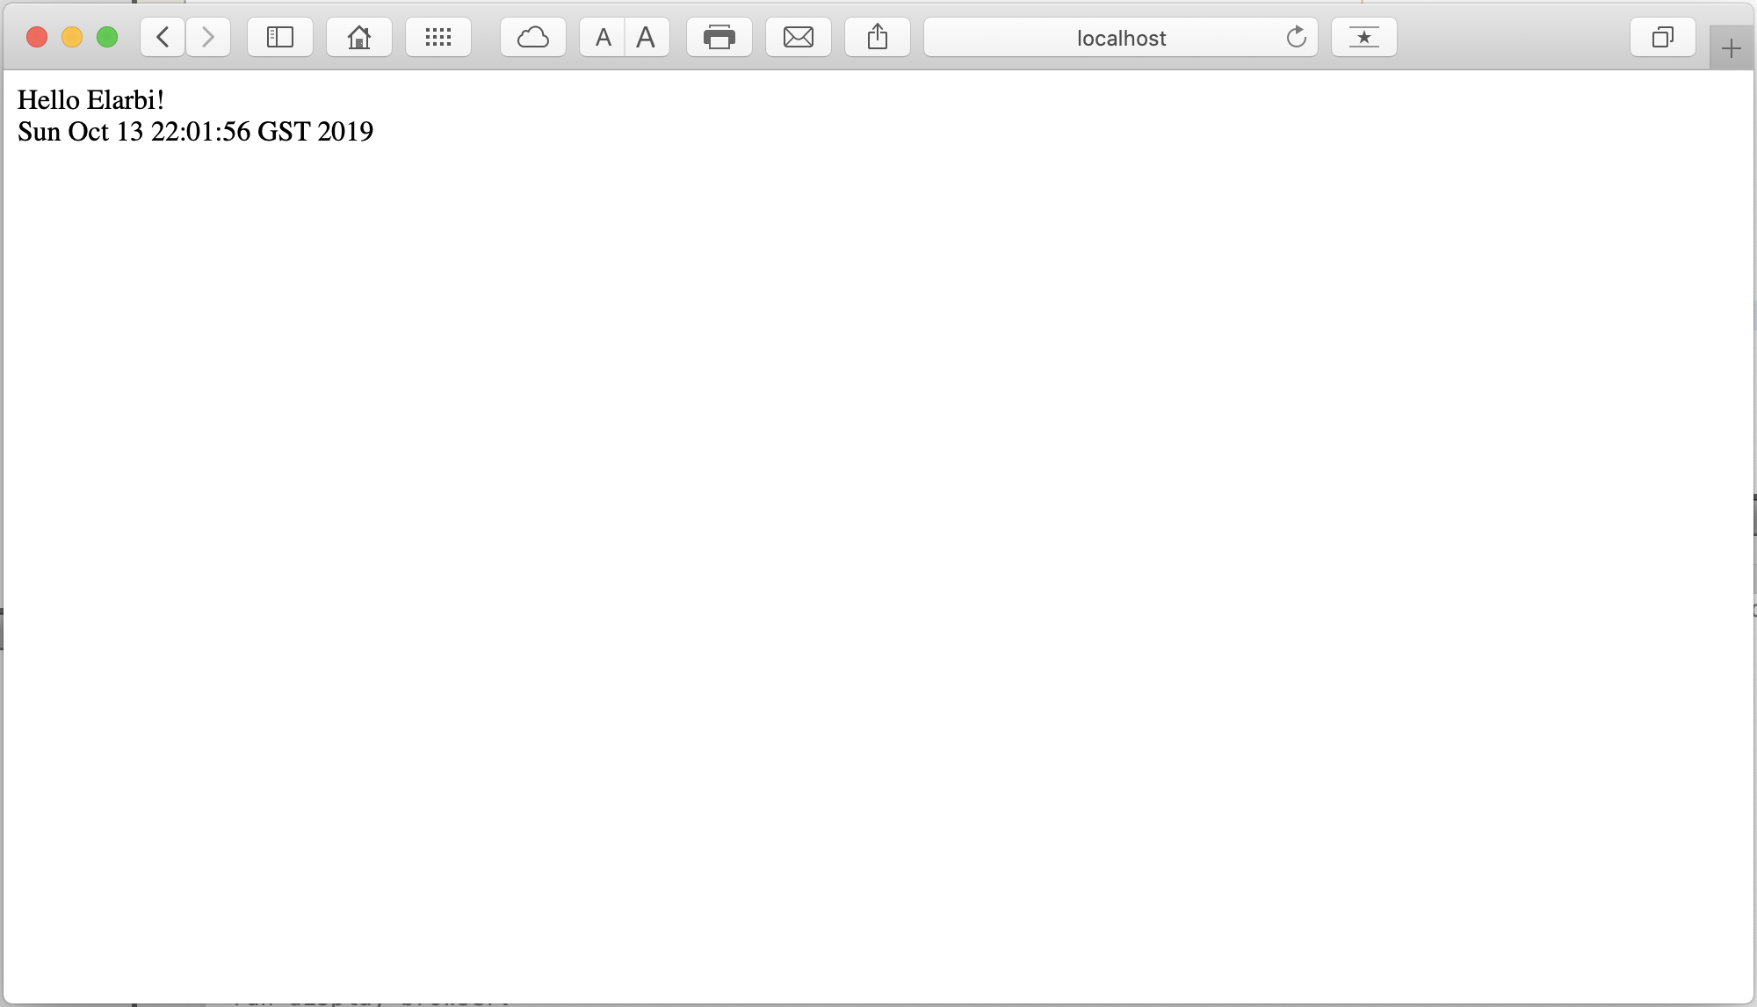
First Simple Interactive JSP example (cont.)

Slide 23
First Simple Interactive JSP example (cont.)
The page helloJsp.jsp is placed in the same directory as index.html and WEB-INF. All HTML tags can be used in a JSP page since JSP is an extension of HTML. A JSP file can be placed anywhere an HTML file can be placed.
<%@ page import="java.util.*" info = “ This is a simplest JSP with Java code embedded” contentType = “text/html” %>
<%! Date today; %>
<html>
<%-- This is a Simplest JSP (comment from JSP tag -- %>
<body>
<!-- This is a simplest JSP (Comment from HTML tag -->
Hello <%= request.getParameter("userName") %>!
<br>
<% today = new Date(); %>
<%= today %>
</body>
</html>

Slide 24
JSP Syntax Elements
<html>
<body>
<%@ page language = "java" %>
<%@ page import = "java.util.*" %>
<%@ page session = "true" %>
<%@ page errorPage = "error.html" %>
<%@ page contentType="text/html;charset=ISO-8859-1" %>
<%@ include file = "welcome.html" %>
<%! int count = 0 ; %>
<% count++ ; %>
<%= count %>
<%-- JSP Comments --%>
</body>
</html>
Directives
Declarations
Scriplets
Expressions
Comments

Slide 25
First Simple Interactive JSP example (cont.)
The first line is a JSP directive element tag (<%@ . . . %>) which directs the JSP engine to set the page structure. It will not result in any Servlet code, just like the import directive in Java.
This directive element tells the JSP engine to import all classes in the java.util package to allow use of the Date class and tells JSP engine that content type of this page is text/html not text/xml.
The second line is a JSP declaration element <%! . . . %> which tells the JSP engine to insert the enclosed java code into the generated Servlet java source code somewhere outside of any method.
<%-- . . . %> is a JSP comment scripting element which stays on the server while <!-- . . . --> is a regular HTML comment which is sent back to the client.

Slide 26
First Simple Interactive JSP example (cont.)
The expression scripting element <%= . . . %> will display values of the enclosed expression in string format. In this JSP example, the helloJsp.jsp gets the parameter input string by the getParameter() method of HttpServletRequest object.
The input string either comes from the input text field of the request form or the URL query string of this JSP address. The “userName” of the getParameter() method matches the “userName” text input component name in the HTML form.
The next JSP scripting element is scriptlet (java servelt code) which is insered into the service() method of the generated Servlet code JSP instantiates a new instance of Date class and the current date is displayed in the next expression scripting element.

Slide 27
Directives
Directives provide general information about the JSP page to the JSP engine.
<%@ page language = "java" %>
Informs the JSP engine that we will be using java as the scripting language in our JSP page. As of JSP 1.2, java is the only one allowed.
<%@ page import = "java.util.*" %>
Imports classes and packages that we want to use in the JSP page.
example
<html>
<body>
<%@ page import="java.util.*" %>
...
<%
...
LinkedList list = new LinkedList();
...
%>
...
</body>
</html>

Slide 28
Directives
<%@ page session = "true" %>
Specifies whether the JSP page takes part in an HTTP session (more details will be given in the Implicit Variables Section).
<%@ page errorPage = "error.html" %>
Used to delegate the exceptions to another HTML or JSP page.
example
<html>
<body>
<%@ page errorPage="error.html" %>
...
<%
...
int i = Integer.parseInt ( "1s7" );
...
%>
...
</body>
</html>

Slide 29
Directives
<%@ page contentType = "text/html;charset=ISO-8859-1" %>
Specifies the content type and Character Encoding for the output.
example
<%@ page contentType="application/vnd.ms-excel" %>
This is a Test
1 2 3 4
5 6 7 8
This is a tabulation

Slide 30
Directives
<%@ include file = "header.html" %>
Tells the JSP engine to include the contents of another file (HTML, JSP,..) in the current page.
example1.jsp
header.html
<html>
<body>
<%@ include file="header.html“ %>
...
</body>
</html>
<html>
<body>
Welcome to the ADU
</body>
</html>
example2.jsp
header.jsp
<html>
<body>
<%@ include file="header.jsp" %>
...
</body>
</html>
<html>
<body>
<%@ page import="java.util.*“ %>
<%= (new Date()).toString() %>
</body>
</html>

Slide 31
Declarations
<html>
<body>
<%@ page language = "java" %>
<%@ page import = "java.util.*" %>
<%@ page session = "true" %>
<%@ page errorPage = "error.html" %>
<%@ page contentType="text/html;charset=ISO-8859-1" %>
<%@ include file = "welcome.html" %>
<%! int count = 0 ; %>
<% count++ ; %>
<%= count %>
<%-- JSP Comments --%>
</body>
</html>
Directives
Declarations
Scriplets
Expressions
Comments

Slide 32
Declarations
Declarations define Variables and Methods that can be used in the JSP page.
<%! int count = 0 ; %>
example 1
<html>
<body>
<%! int count = 0 ; %>
...
</body>
</html>
Don’t forget it
example 2
<html>
<body>
<%!
String color [] = { ″red″ , ″green″ , ″blue″ };
String getColor ( int i )
{
return color[ i % 3 ] ;
}
%>
</body>
</html>

Slide 33
Scriplets
<html>
<body>
<%@ page language = "java" %>
<%@ page import = "java.util.*" %>
<%@ page session = "true" %>
<%@ page errorPage = "error.html" %>
<%@ page contentType="text/html;charset=ISO-8859-1" %>
<%@ include file = "welcome.html" %>
<%! int count = 0 ; %>
<% count++ ; %>
<%= count %>
<%-- JSP Comments --%>
</body>
</html>
Directives
Declarations
Scriplets
Expressions
Comments

Slide 34
Scriplets
Scriplets are Java code fragments that are embedded in the JSP page.
<% count++ ; %>
example
<html>
<body>
<%
int sum = 0 ;
for ( int i = 0 ; i <= 1000 ; i++ )
sum += i ;
%>
</body>
</html>

Slide 35
Expressions
<html>
<body>
<%@ page language = "java" %>
<%@ page import = "java.util.*" %>
<%@ page session = "true" %>
<%@ page errorPage = "error.html" %>
<%@ page contentType="text/html;charset=ISO-8859-1" %>
<%@ include file = "welcome.html" %>
<%! int count = 0 ; %>
<% count++ ; %>
<%= count %>
<%= myBean.getSalary() %>
<%-- JSP Comments --%>
</body>
</html>
Directives
Declarations
Scriplets
Expressions
Comments

Slide 36
Expressions
The expression is evaluated each time the JSP Page is accessed, and its value is then embedded in the output HTML.
<%= count %>
example
<html>
<body>
<%
int sum = 0 ;
for ( int i = 0 ; i <= 1000 ; i++ )
sum += i ;
%>
<%= sum %>
</body>
</html>

Slide 37
Comments
<html>
<body>
<%@ page language = "java" %>
<%@ page import = "java.util.*" %>
<%@ page session = "true" %>
<%@ page errorPage = "error.html" %>
<%@ page contentType="text/html;charset=ISO-8859-1" %>
<%@ include file = "welcome.html" %>
<%! int count = 0 ; %>
<% count++ ; %>
<%= count %>
<%-- JSP Comments --%>
</body>
</html>
Directives
Declarations
Scriplets
Expressions
Comments

Slide 38
Comments
Comments do not affect the output of a JSP page but are useful for documentation purposes.
<%-- JSP Comment --%>
example
<html>
<body>
<%-- JSP Comment --%>
<% // Java Comment %>
<!-- HTML Comment -->
</body>
</html>

Slide 39
Example
MySum.jsp
<html>
<body>
<%! int sum = 0 ; %>
<%
for ( int i = 1 ; i <= 1000 ; i++ )
sum += i ;
%>
The sum is <%= sum %>
</body>
</html>
HTML Page
<html>
<body>
The sum is 500500
</body>
</html>

Slide 40
MySum_jsp.java
...
public final class MySum_jsp extends …
{
...
int sum = 0 ;
...
public void _jspService ( .. , .. )
{
...
("<html>\r\n ");
out.write("<body>\r\n\r\n ");
out.write("\r\n\r\n\t ");
for ( int i = 1 ; i <= 1000 ; i++ )
sum += i ;
out.write("\r\n\r\n\t The sum is ");
out.write(String.valueOf( sum ));
out.write("\r\n\r\n ");
out.write("</body>\r\n");
out.write("</html>\r\n\r\n");
...
}
...
} out.write

Slide 41
Implicit Variables
During the translation phase, the JSP engine declares and initializes a set of variables in the _jspService ( ) method. They are called implicit variables.
application ( javax.servlet.ServletContext )
Refers to the web application’s environment.
example
<html>
<body>
<%@ page import="java.util.*" %>
...
<%
...
Date currentDateAndTime = new Date();
application.log ("Invocation Date and Time : " +
currentDateAndTime );
...
%>
...
</body>
</html>

Slide 42
Implicit Variables
request ( javax.servlet.http.HttpServletRequest )
Refers to the current request the page.
example 1
<html>
<body>
The Remote Host is : <%= request.getRemoteHost( ) %>
<hr>
The Remote Address is : <%= request.getRemoteAddr( ) %>
<hr>
The Remote Port is : <%= request.getRemotePort( ) %>
</body>
</html>

Slide 43
Login.jsp
<html>
<body>
<%
String login = request.getParameter ( "login" );
String password = request.getParameter ( "password" );
%>
The values entered by the user are :
<br>
login : <%= login %>
<br>
password : <%= password %>
</body>
</html>
The FORM Page
<html>
<body>
Please enter your user name and password :
<form action="Login.jsp" method="POST" >
Login : <input type="text" name="login" >
<br>
Password : <input type="password" name="password" >
<br>
<input type="submit" name="Send" value="Send" >
</form>
</body>
</html>

Slide 44
Implicit Variables
session ( javax.servlet.http.HttpSession )
A session is an uninterrupted series of request-response interactions between a client and a server.
For each request that is a part of this session, the server is able to identify the request as coming from the same client.
A session starts when an unknown client sends the first request to the web application server.
It ends when either the client explicitly ends the session or the server does not receive any requests from the client within a predefined time limit.
When the session ends, the server conveniently forgets the client as well as all the requests that the client may have made.

Slide 45
Example
Page1.jsp
<html>
<body>
<%@ page session="true" %>
<H1> Page 1 </H1>
<%= session.getId ( ) %>
<HR>
<a href="Page1.jsp"> Page1.jsp </a>
<a href="Page2.jsp"> Page2.jsp </a>
<a href="Page3.jsp"> Page3.jsp </a>
</body>
</html>
Page2.jsp
Page3.jsp
<html>
<body>
<%@ page session="true" %>
<H1> Page 2 </H1>
<%= session.getId ( ) %>
<HR>
<a href="Page1.jsp"> Page1.jsp </a>
<a href="Page2.jsp"> Page2.jsp </a>
<a href="Page3.jsp"> Page3.jsp </a>
</body>
</html>
<html>
<body>
<%@ page session="true" %>
<H1> Page 3 </H1>
<%= session.getId ( ) %>
<HR>
<a href="Page1.jsp"> Page1.jsp </a>
<a href="Page2.jsp"> Page2.jsp </a>
<a href="Page3.jsp"> Page3.jsp </a>
</body>
</html>

Slide 46
Passing Parameters between JSP Pages
Login.jsp
<html>
<body>
<%@ page session="true" %>
<%
String login = request.getParameter ( "login" );
String password = request.getParameter ( "password" );
session.setAttribute ( "user" , login );
session.setAttribute ( "pass" , password );
%>
<H3> Stored Values : </H3>
<%= login %> , <%= password %>
<HR>
<a href="NextPage.jsp">NextPage.jsp</a>
</body>
</html>

Slide 47
Passing Parameters between JSP Pages ( cont. )
NextPage.jsp
<html>
<body>
<%@ page session="true" %>
<%
String login = ( String ) session.getAttribute ( “user" );
String password = ( String ) session.getAttribute ( "pass" );
%>
<H3> Extracted Values : </H3>
<%= login %> , <%= password %>
</body>
</html>

Slide 48
Passing Parameters between JSP Pages ( cont. )
User.java
package is300;
public class User
{
private String userName ;
private String password ;
public User ( String _userName , String _password )
{
userName = _userName ;
password = _password ;
}
public String getUserName()
{
return userName ;
}
public String getPassword()
{
return password ;
}
}

Slide 49
Passing Parameters between JSP Pages ( cont. )
Login2.jsp
<html>
<body>
<%@ page session="true" %>
<%@ page import="is300.*" %>
<%
String login = request.getParameter ( "login" );
String password = request.getParameter ( "password" );
User userObject = new User ( login , password );
session.setAttribute ( "user" , userObject );
%>
<H3> Stored Values : </H3>
<%= login %> , <%= password %>
<HR>
<a href="NextPage2.jsp">NextPage2.jsp</a>
</body>
</html>

Slide 50
Passing Parameters between JSP Pages ( cont. )
NextPage2.jsp
<html>
<body>
<%@ page session="true" %>
<%@ page import="is300.*" %>
<%
User user = ( User ) session.getAttribute ( "user" );
%>
<H3> Extracted Values : </H3>
<%= user.getUserName( ) %> , <%= user.getPassword( ) %>
</body>
</html>

Slide 51

JSP STANDARD ACTIONS

Slide 52
JSP forward Action
JSP standard action elements simplify the access actions to other Web components such as Servlet, JSP, or JavaBean components.
This action forwards the request to another page, i.e. an internal redirect.
For example, it forwards the control from current page to second.jsp.
<jsp:forward page="another page" />
<jsp:forward page='second.jsp'/>

Slide 53
JSP include Action
In addition to the JSP page include directive that includes a page at the JSP translation time, JSP also supports an action that can dynamically include a page at run-time.
The jsp:include action element is like a function call. At runtime, the included file will be ‘executed’ and the result content will be included with the source JSP page.
When the included JSP page is called, both the request and response objects are passed as parameters.
Remember that the include directive only copies the contents once and never changes afterwards since it is static.
<jsp:include page = “<JSP or html page>” />

Slide 54
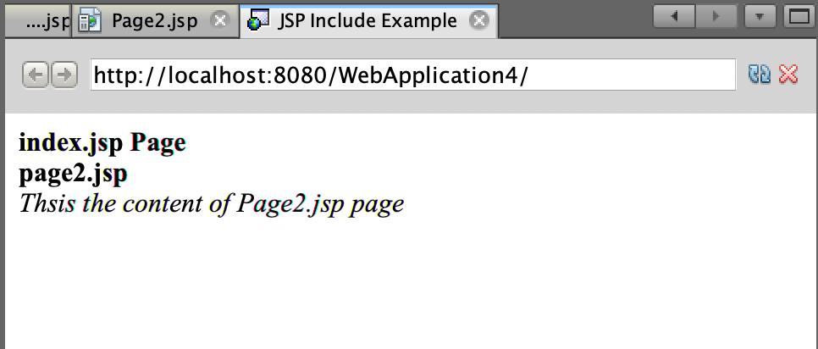
Example 1: <jsp:include> without parameters
In this example we will use <jsp:include> action tag without parameters. As a result the page will be included in the current JSP page as it is:
index.jsp
<html>
<head>
<title>JSP Include example</title>
</head>
<body>
<b>index.jsp Page</b><br>
<jsp:include page="Page2.jsp" />
</body>
</html>
Page2.jsp
<b>Page2.jsp</b><br>
<i> This is the content of Page2.jsp page</i>

Slide 55
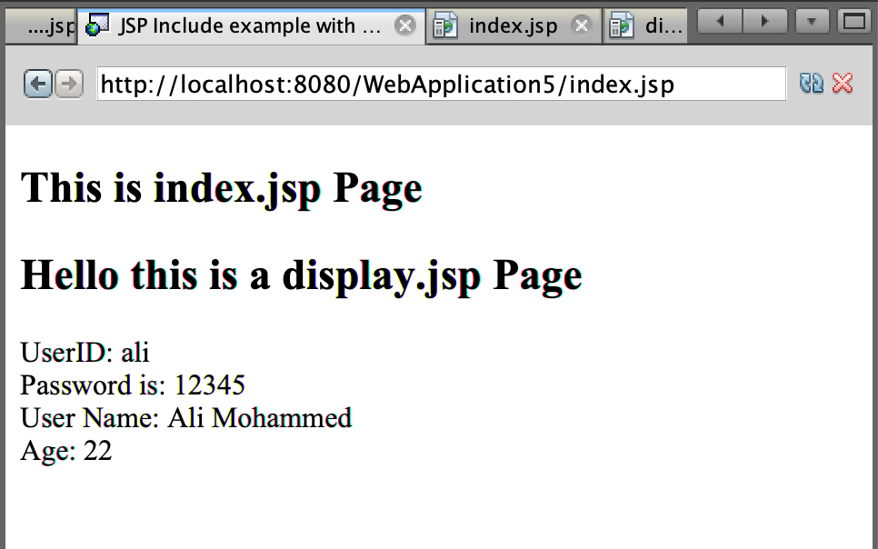
Example 2: Use of <jsp:include> along with <jsp:param>
index.jsp
I’m using <jsp:include> action here along with <jsp:param> for passing parameters to the page which we are going to include.
<html>
<head>
<title>JSP Include example with parameters</title>
</head>
<body>
<h2>This is index.jsp Page</h2>
<jsp:include page="display.jsp">
<jsp:param name="userid" value="ali" />
<jsp:param name="password" value="12345" />
<jsp:param name="name" value="Ali Mohammed" />
<jsp:param name="age" value="22" />
</jsp:include>
</body>
</html>
display.jsp
<html>
<head>
<title>Display Page</title>
</head>
<body>
<h2>Hello this is a display.jsp Page</h2>
UserID: <%=request.getParameter("userid") %><br>
Password is: <%=request.getParameter("password") %><br>
User Name: <%=request.getParameter("name") %><br>
Age: <%=request.getParameter("age") %>
</body>
</html>

Slide 56
JSP JavaBean Actions
JavaBean Components
JSP provides a number of JSP javaBean action elements to free JSP page designers from complex Java Servlet programming or JSP scripting constructs.
A JavaBean is a wrapper for business logic and data processing. Any Java class can be converted to a JavaBean class as long as it satisfies the JavaBean convention (design pattern).
You can easily create and initialize beans and set and get the values of their properties. A simple bean named Book is given below.
The JSP actions can only call set and get methods. Other JSP scriptlets can call other methods. The bean class file is placed in Tomcat WEB-INF/classes along with the Servlet class.

Slide 57
JavaBean Components (cont.)
package shopping;
public class Book implements java.io.Serializable{
String title;
String isbn;
float price;
int quantity;
public Book() {
title="";
isbn="";
price=0;
quantity=0;
}
public void setTitle (String name) {
title=name;
}
public String getTitle () {
return title;
}
public void setIsbn (String id) {
isbn=id;
}
public String getIsbn () {
return isbn;
}
public void setPrice (float p) {
price=p;
}
public float getPrice () {
return price;
}
public void setQuantity (int q) {
quantity=q;
}
public int getQuantity () {
return quantity;
}
}

Slide 58
jsp:useBean Action Element
The jsp:useBean action instantiates an instance of the bean class if there is not an existing one or creates a reference to an existing one. It also specifies the visibility and accessibility scope of this bean. The other Web components in JSP can reference this bean object by its id. Its syntax is given as:
The id is the access name of this bean. The scope attribute defines the visibility of this bean.
<jsp:useBean id="name" class=”<package>.<Java bean class>” scope=”. . .”>
page Only active in the page , default scope
request Active for the current request
Session Active for the current session
application Active for the current application

Slide 59
jsp:useBean Action Element (cont.)
After you get a reference to a bean you can use jsp:setProperty action and jsp:getProperty action to modify and retrieve the bean properties.
Once you have a bean reference, you can also modify its properties by calling the bean’s getXXX() or setXXX() methods explicitly in a scriptlets element.
Note that the class specified for the bean must be in the server's regular class path. For example, in Tomcat, this class and all the classes it uses should go in the classes directory or be in a jar file in the lib directory.
You can also incorporate Java code into the body of a jsp:useBean tag so that the incorporated code will be executed when the bean is instantiated for the first time. If the instance exists already the code will be ignored.
<jsp:useBean ...>
Java code
</jsp:useBean>

Slide 60
jsp:setProperty Action
You use jsp:setProperty to assign values to properties of a bean. You can either use jsp:setProperty after, but outside of, a jsp:useBean element or within the body of jsp:useBean action element.
Option 1:
In this case, the jsp:setProperty is executed regardless of whether a new bean was instantiated or an existing bean was found.
<jsp:useBean id="myBook" ... />
<jsp:setProperty name="myBook" property="price" ... />

Slide 61
jsp:setProperty Action (cont.)
Option 2:
In this case, the jsp:setProperty is executed only if a new object is instantiated, i.e., no existing bean object exists yet.
The following action sets myBook’s price property to 31.99.
<jsp:useBean id="myBook "...>
…..
<jsp:setProperty name= “myBook" property="price" ... />
</jsp:useBean>
<jsp:setProperty name="myBook" property="price" value = “31.99” />

Slide 62
jsp:setProperty Action (cont.)
The required “name” attribute is the id of the bean specified in <jsp:useBean> action tag.
The required “property” attribute specifies the property you want to set. You can also assign a "*" to the property if all request parameter names match bean property names. It will set all corresponding properties of the bean with the values of request parameters either from request form or request string.
The “value” attribute specifies the value for the property. The String type value will be converted to the correct type for the property.

Slide 63
jsp:setProperty Action (cont.)
You can also associate the bean properties with the input parameters. The next example shows that the bookPrice input parameter in the request form or query string is associated with the price property of myBook bean.
Or you can associate all properties with input request parameters with the “*” wildcard character. Assume that there are four input request parameters whose names match four property names: title, isbn, price, and quantity. Whatever data you input to the parameters will be assigned to the properties with same names. This is one of the most useful javaBean features.
<jsp:setProperty name="myBook" property="price" param="bookPrice" />
<jsp:setProperty name="myBook" property="*" />

Slide 64
jsp:setProperty Action (cont.)
You can't use both value and param at same time, but it is allowed to use neither. If you use neither param nor value, that indicates that a parameter name matches the property name. JSP will take the input from the parameter which has the same name as the property name.
jsp:setProperty action is much more powerful than the setXXX() methods in that it can automatically convert String type data to the required data type of the bean property and set multiple properties using only one single command.

Slide 65
jsp:getProperty Action Element
This element retrieves the value of a bean property, converts it to a string, and inserts it into the JSP outputs. The two required attributes are name – the id of a bean defined via jsp:useBean, and property – the property whose value should be inserted.
<jsp:useBean id='myBook'
class='shopping.Book'
scope='session' >
...
The next action can return the number of copies of myBook, which may reference a specific book at the time.
<jsp:getProperty name="myBook" property="quantity" />
To return the price of the same book:
<jsp:getProperty name="myBook" property="price" />
</jsp:useBean>

Slide 66
jsp:getProperty Action Element(cont.)
The form.jsp takes user name input on the form request, and calls response.jsp. The response.jsp JSP page saves the input in a JavaBean, gets the username from the bean, and finally it responds to the user with a message “Hello, <user name>”.
This is the form.jsp.
<html>
<body>
<form method=”get” action=”response.jsp”>
<input type=”text” name=”userName” size=”20”>
<br>
<input type=”submit” value=”Submit”>
</form>
</body>
</html>

Slide 67
jsp:getProperty Action Element (cont.)
Here is the NameBean javaBean file.
Here is the response.jsp file
package user;
public class NameBean {
String userName;
public NameBean() { userName=null; }
Public void setUserName (String name) { userName=name; }
public String getUserName() { return userName; }
}
<%@ page import=user.NameBean” %>
<jsp:useBean id=”myBean” scope=”request” class=”user.NameBean” />
<jsp:setProperty name=”myBean” property=”*” />
<html><body>
<h1>Hello, <jsp:getProperty name=”myBean” property=”userName” /><h1>
</body></html>

Slide 68
jsp:plugin Action Element
The jsp:plugin action can insert an Java Applet client-side component into a server-side JSP page component. It downloads Java plug-in software (if necessary) and client-side component such as Applet and executes the client-side component.
The syntax is as follows.
<jsp:plugin type=”applet” code=”MyApplet.class” width=”400” height=”200”>
. . .
<!-- Parameter lists passed on the current JSP -->
<jsp:param name=”username” value=”Smith” />
…
</jsp:plugin>

Slide 69
jsp:plugin Action Element (cont.)
The <jsp:plugin> element can display an Applet object or a bean object in the client Web browser, using a Java plug-in which is part of the browser or downloaded from a specified URL.
When the JSP file sends an HTML response to the client, the <jsp:plugin> element is replaced by an <object> element in HTML specification. In general, the attributes to the <jsp:plugin> element specify whether the object is a bean or an applet, locate the code that will be run, position the object in the browser window, specify an URL from which to download the plug-in software, and pass parameter names and values to the object.

Slide 70
JSP implicit variables (cont.)
application: represents the ServletContext obtained from servlet configuration object. You can set a attribute by application.setAttribute(key,value) and get the attribute value by application.getAttribute (key). The application object has Application scope.
config: represents the ServletConfig for the JSP. The JSP initialization parameters can be read via it. It has a page scope.
page: synonym for the "this" operator. Not used often by page authors.
session: an HttpSession object with session scope. session.setAttribute(key,data); session.getAttribute(key), and session.getId() are examples.
These implicit objects are only visible within the system generated _jspService() method.

Slide 71
JSP CUSTOMIZED TAG

Slide 72
Custom Tag Library
A custom tag library feature allows JSP developers to define their own reusable custom tags. Customized tags are stored in tag libraries called taglibs. The advantages of custom tags are as follows:
Separates HTML page authoring from Java programming.
Encapsulates complex Java code behind the tag interface that makes it easy to reuse.
Easy to maintain because any change of tag implementation will not result in any change of the tag application.
In order to make custom tags work, there must be a XML descriptor file to map the tag to its implementation class file, called the tag handler class; there must also be a Java tag handler class. Of course, the custom defined tag is used in a JSP file. Figure 4.4 shows the relations among these three files.

Slide 73
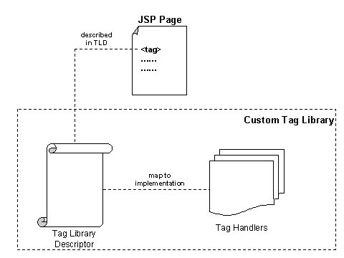
Custom Tag Library

Slide 74
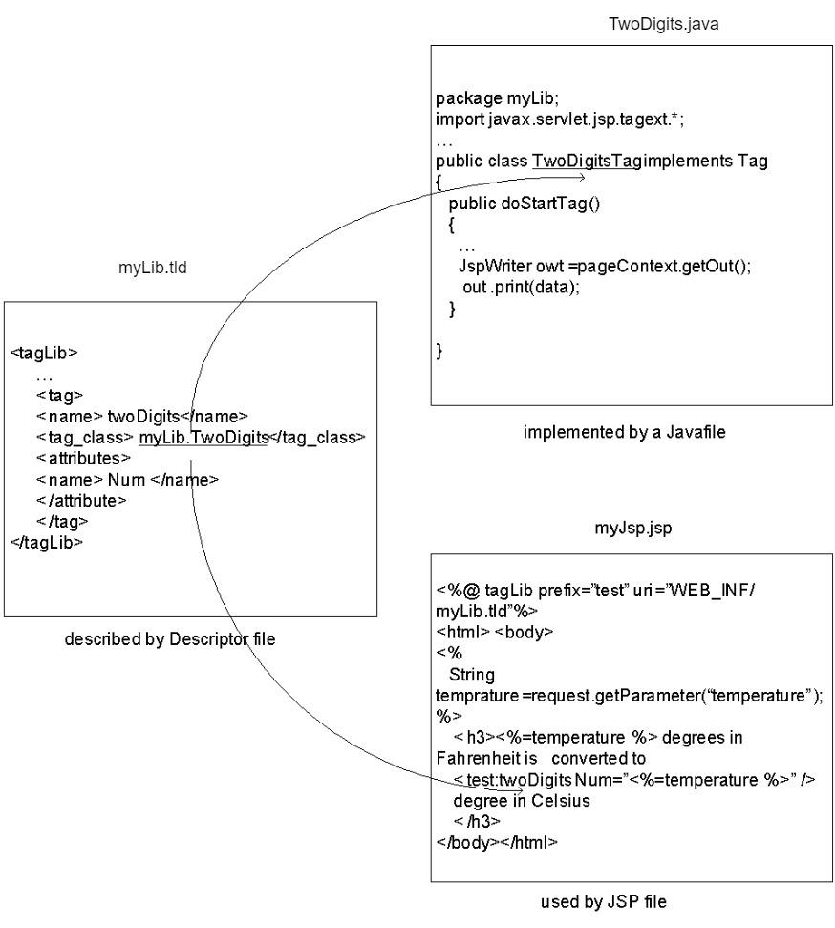
Custom Tag Library

Slide 75
Tag implementation class
First, let’s discuss the WelcomeTag tag handler class which just displays “Welcome!” The file is saved in webapps\tagLib\myLib\WelcomeTag.java in Tomcat where taglib is this Web application root directory.
package myLib;
import javax.servlet.jsp.*;
import javax.servlet.jsp.tagext.*;
import java.io.*;
public class WelcomeTag implements TagSupport {
{

Slide 76
Tag implementation class (cont.)
public int doStartTag() throws JspException
{
try
{
JspWriter out = pageContext.getOut();
out.print(“ Welcome! ”);
}
catch(Exception e)
{
throw new JspException("error");
}
return SKIP_BODY;
}
}

Slide 77
Tag implementation class (cont.)
The container invokes the doStartTag() when the start-tag is encountered. It is processed in the same way as the Java Simple API for XML parser (SAX) handles XML tag elements.
Next, let’s look at the application of this welcome tag used in the webapps\tagLib\myFirst.jsp
This JSP specifies the location of the myLib.tld file which maps the definition of Welcome custom tag to its
WelcomeTag tag handler class file. The prefix attribute in the taglib directive plays a role of “namespace”. When this myFirst.jsp file is browsed the word “Welcome!” is displayed on the browser screen.
<%@ taglib prefix="test" uri="/WEB-INF/myLib.tld" %>
<html><body>
<test:welcome/>
</body></html>

Slide 78
Tag implementation class (cont.)
The webapps\tagLib\WEB-INF\myLib.tld defines the welcome tag and maps the welcome tag name to its tag handler class myLab.Welcome.class.
<!DOCTYPE taglib
PUBLIC "-//Sun Microsystems, Inc.//DTD JSP Tag Library 1.2//EN"
"http://java.sun.com/j2ee/dtd/web-jsptaglibrary_1_2.dtd">
<taglib>
<!-- INFO ABOUT THIS LIBRARY -->
<tlib-version>1.0</tlib-version>
<jsp-version>1.2</jsp-version>
<short-name>myLib</short-name>
<!-- GREET TAG -->
<tag>
<name>welcome</name>
<tag-class>myLib.WelcomeTag</tag-class>
<body-content>empty</body-content>
</tag>
</taglib>

Slide 79
JSP 2.0 EXPRESSION LANGUAGE

Slide 80
Expression Language (EL)
A new feature of JSP technology version 2.0 is the Expression Language (EL). The EL is a simple and very powerful notation which makes it easier for the JSP page author to write code for accessing application data such as data stored in JavaBean components and attribute data of pageContext, request, session, and application. EL uses a shorthand notation of ${expr } instead of <%= expr %>.
For example, you have a Book JavaBean class in shopping package
package shopping;
public class Book {
. . .
float price;
public Book() {
. . .
price= 0;
}
. . .
public void setPrice(float p) {
price=p;
}
public float getPrice() {
return price;
}
. . .
}

Slide 81
Expression Language (EL) (cont.)
After you specify
<jsp:useBean id=”myBook” class=”shopping.Book” scope=”session” />
you can use ${myBook.price} to get the value of the price property of the bean instead of using the following scripting elements:
<%@ page import=”shopping.Book” @>
<% Book myBook = new Book(); %>
. . .
<%= myBook.getPrice() %>
You can also use ${myBook.price} to replace the following JSP action elements:
<jsp:getProperty name=”myBook” property=”price” />
If the myBook.price does not exist the expression just returns Null value rather than throwing an exception.

Slide 82
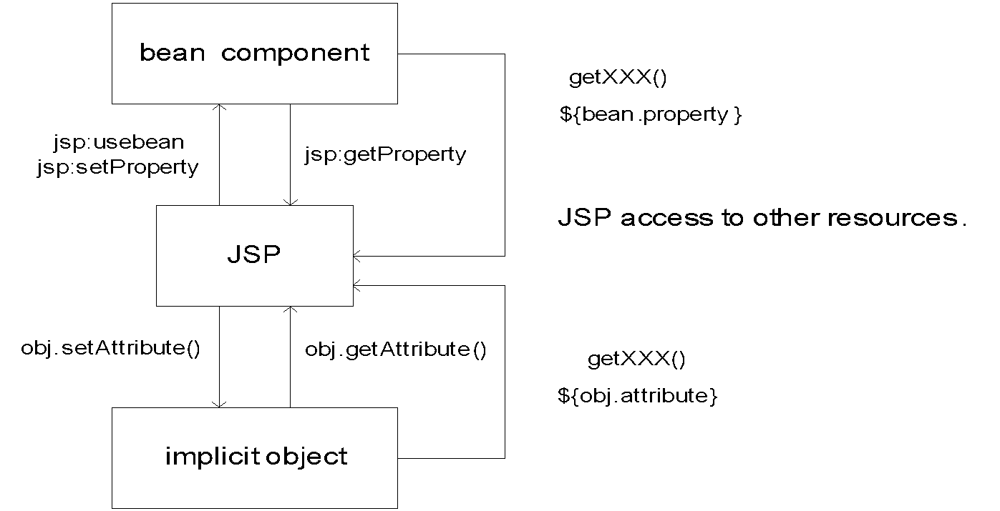
Expression Language (EL) (cont.)
The Expression Language also simplifies access to collection type data: request parameters, cookies, etc. It supports the conditional expression ${test? Opt1, Opt2} which is an alternative to a scriptlet element. It also supports automatic type conversion.
Addition to above, another useful feature of EL is the nested notation, such as ${student.address.state} where state is a property of address class and the address is a property of the student class. EL can retrieve data but can never set any data because EL is an expression language only.

Slide 83
General syntax for bean access
${expr1.expr2} or ${expr1[“expr2”]} where expr1 is the bean reference and expr2 is the property of the bean.

Slide 84
Syntax for collection data access
${expr1[expr2]} where expr1 is a reference to an array or a list and expr2 is an integer index.
For example, ${myList[2]} returns a value at 3rd position of this list.
${expr1[expr2]} or ${expr1.expr2} where expr1 is a map and expr2 is the key of the map that the value of this key is returned. For example, ${myMap[“Smith”]} returns the phone number of Smith. There is an entry in the MyMap for Smith.
Examples
${param['userName']} is equivalent EL notation to <%=request.getParameter("userName") %>
${pageContext.session.id} returns an id number of the session the page belongs to.

